Slide 1
Rice Leaf Disease Detection using Efficientnet

Slide 2
ABSTRACT
Recent developments in Deep Learning show that Automatic Image Recognition systems using Convolutional Neural Network (CNN) models can be very beneficial in such problems. Since rice leaf disease image dataset is not easily available, we have created our own dataset which is small in size hence we have used Efficientnetb5 Architecture to develop our deep learning model. The proposed system is based on Efficientnetb5 Architecture is trained and tested on the dataset collected from rice fields and the internet. The accuracy of the proposed model is training accuracy of 95.34%. and validation accuracy of 96.00%.

Slide 3
EXISTING SYSTEM
P. Konstantinos Ferentinos, proposed CNN is trained using 87,848 images, with 25 plant varieties having 58 classes which includes healthy plants. Different types of models were trained, of which the best model provided 99.53% accuracy in correct identification.

Slide 4
Y. Lu et.al. collected 500 images of 10 different rice diseases of leaf and stem. They developed an architecture inspired by Le-Net and AlexNet and achieved 95.48% on the test set. Since the data is very less they used various preprocessing step like image resizing to 512*512, normalization, PCA and whitening. They used stochastic pooling instead of max pooling and stated that it prevents over fitting.

Slide 5
DISADVANTAGES OF EXISTING SYSTEM
A lot of research has been done using traditional classifiers but the results are dependent on the feature selection techniques and image preprocessing is a major step.
Lesser accuracy.
More complex model.
Time taking process.

Slide 6
PROPOSED SYSTEM
In this work we have proposed the architecture for the disease classification part of the automated system. In this work, we have developed the deep learning approach on our rice disease dataset that we have collected over past several months. We have used Efficientnetb5 Architecture for the prediction of rice leaf disease.

Slide 7
This proposed system presents a rice leaf disease detection system using Efficientnetb5 Architecture. Three of the most common rice plant diseases namely leaf smut, bacterial leaf blight and brown spot diseases are detected in this work. Clear images of affected rice leaves with white background were used as the input. After necessary pre-processing, the dataset was trained on with Efficientnetb5 Architecture, achieved a training accuracy of 95.34% and validation accuracy of 96.00%

Slide 8
ADVANTAGES OF PROPOSED SYSTEM
The proposed system has both higher accuracy and better efficiency over existing CNNs, reducing parameter size and FLOPS by an order of magnitude.
The proposed achieved state-of-the-art accuracy of 96% which is best when compared to the existing systems.
The proposed system could potentially serve as a new foundation for future computer vision tasks

Slide 9
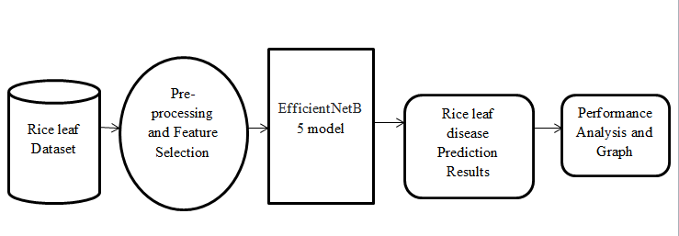
SYSTEM ARCHITECTURE

Slide 10
HARDWARE REQUIREMENTS
System : Pentium i3 Processor.
Hard Disk : 500 GB.
Monitor : 15’’ LED
Input Devices : Keyboard, Mouse
Ram : 4 GB

Slide 11
SOFTWARE REQUIREMENTS
Operating system : Windows 10 / 11.
Coding Language : Python 3.8.
Web Framework : Flask.
Frontend : HTML, CSS, JavaScript.

